Slide 1
SHENANDOAH VALLEY DISCOVERY MUSEUM
Ashlyn Martin
Cameron Alt
Chelsey Pineda
Yishak Desta
OUR ROLE: UX designers
TOOLS: Figma, Trello.com, Slack
Mobile Project 2
Notes:
yishak

Slide 2
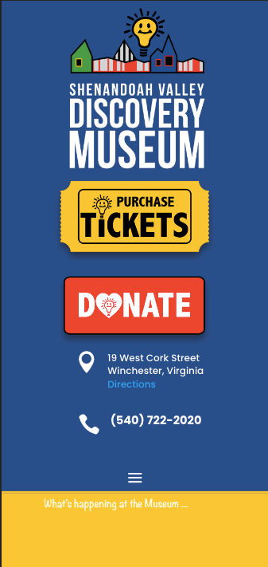
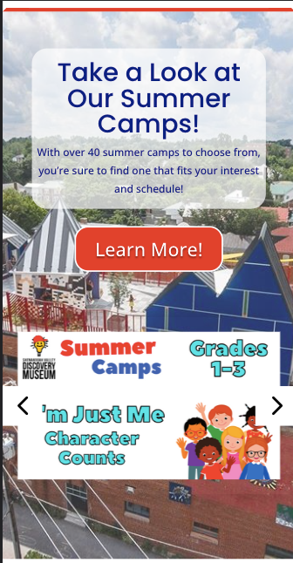
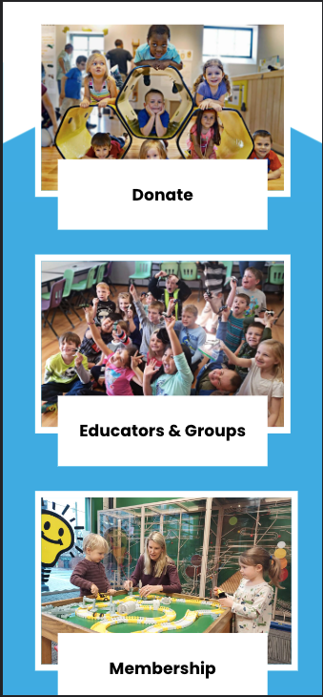
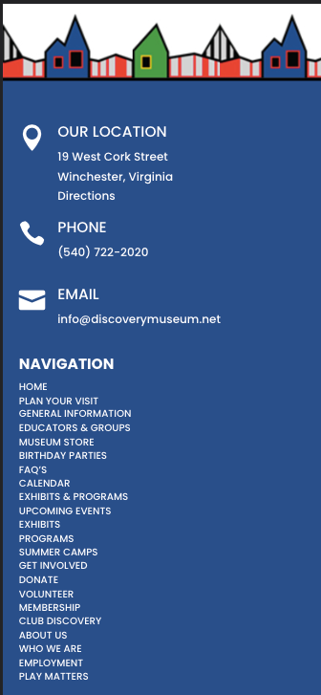
Shenandoah Valley Discovery Museum Initial Thoughts…
Failed to meet professional standards
Lack of clear mission statement and direction
Excessive use of large headers and footers
Inconsistent color palette distracted from cohesiveness
Graphics were not engaging
Lack of direct booking components
Notes:
https://docs.google.com/document/d/1Y_p8r5DO8Q_sZDjPUtuPG5RfLSex4LEQesq0gHkVexc/edit?usp=sharing

Slide 3
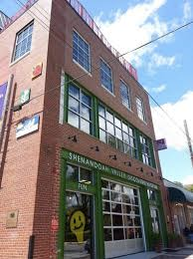
What SVDM does..
Provides interactive and hands-on learning experiences that inspire curiosity, creativity, and critical thinking in children. Through engaging exhibits and programs, the museum aims to foster a love for learning, exploration, and discovery, while promoting a deeper understanding of science, technology, engineering, arts, and mathematics (STEAM) concepts.
Notes:
yishak

Slide 4
User Motivation and Problem Solving
OUR PROCESS
01. USER RESEARCH
02. IDEATION
03. DESIGN
04. ITERATION
05. CLICKABLE PROTOTYPE
Defined User Motivation:
streamline booking process and incorporate interactive features tailored for children
Created an interview plan:
"What opportunities would you like for children to be able to access?"
Conducted 5 interviews:
Spent 15-3- minutes with teachers and parents between the ages of 20-55
Notes:
Yishak
https://docs.google.com/document/d/1hOu_JqkL0I131_deLeKEH4VzUopyJTk7mP5uSztUSFk/edit?usp=sharing

Slide 5
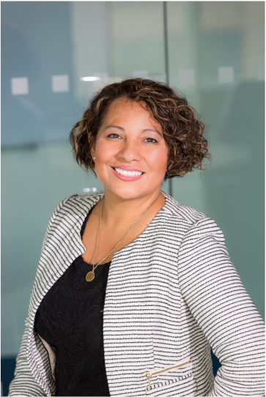
Proto Persona
Goals:
Educational events
Planning age appropriate trips
Accessibility
Demographics:
Age: 32
Personality: Friendly, Family-Orientated
Occupation: Teacher
Likes: Visual learning, field trips, sensory Items
Dislikes: Limited information, donation prioritization
Pain Points & Potential Solutions:
Booking process is outdated
Potential Solution - A proper booking form for field trips
Lack of features for children
Potential Solution - create an interactive page for children
Donation button is too forced
Potential Solution - create a donation button that invites users to donate with compelling features
Madison Smith
Notes:
Ashlyn
https://www.figma.com/file/fYC9zepglF2TXGKLNWV0Xk/Proto-Persona-(Copy)?type=design&t=FyPDo6RdIYBLgKm6-1

Slide 6
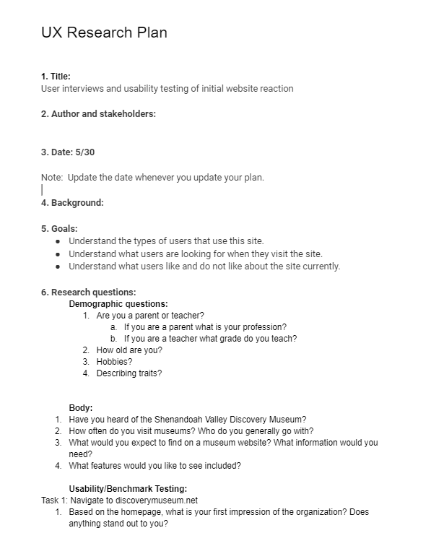
User Research
Notes:
https://drive.google.com/drive/folders/1P1B3MFsNbcHlocvnVRMbbcKXzrXmveMv?usp=sharing

Slide 7
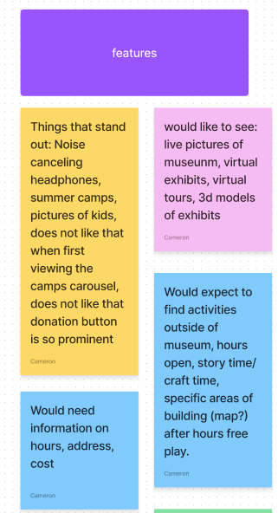
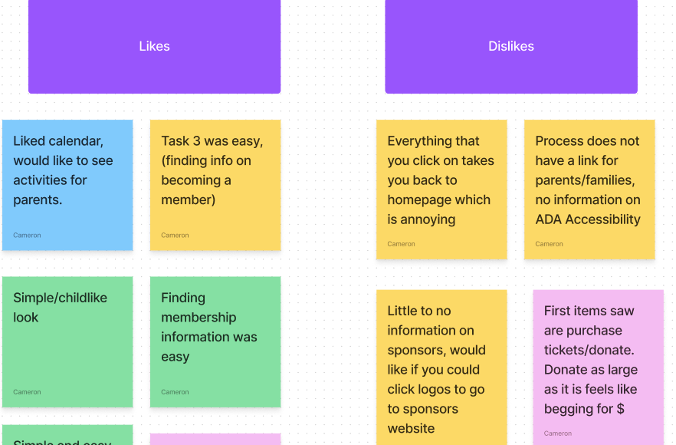
Affinity Diagram
We organized our research by categories and defined our users needs, wants, and likes.
Notes:
Ashlyn
https://www.figma.com/file/mfm1WvoV744ja5Phh3s4AZ/Affinity-Diagram?type=whiteboard&t=FyPDo6RdIYBLgKm6-1

Slide 8
User Persona
Our research told us our users are:
Who:
teacher's and mother's living in the Northern Virginia area
Needs:
information on the where, when, how, and how much
ADA Accessibility, easy booking
Wants:
in-depth information including a map and list of exhibits present at the museum so its better to communicate this information to the school staff and parents
more relevant information on the homepage, such as information relating to the exhibits or the impact the non-profit is making
Frustrations:
better methods for scheduling group visits to the museum outside of “call or email”
donation button is so prominent and the first thing she sees while visiting the site
Notes:
Ashlyn
https://www.figma.com/file/ofgjAzIe512f6l9XOLRzUN/User-Persona?type=design&t=FyPDo6RdIYBLgKm6-1

Slide 9
Competitor Research
Museum of the Southwest
Smithsonian National Museum of Natural History
-More resources and labor
-Extremely easy to find information anywhere on the site
-Registration for programs is easy to accomplish
-Government funded
-Unlimited events and exhibits
-Microinteractions
Museum of the Shenandoah Valley
The Dr. Samuel D. Harris National Museum of Dentistry
-Large amount of resources for funding
-You know what the museum is at first glance
-Layout is simple but impactful
-Public funded museum
-Niche topic
Notes:
Ashlyn
https://docs.google.com/spreadsheets/d/1Y7kvyBuNKUwdmiHbBxIVwUfxs-lPxd_p6o-8gygKmO8/edit?usp=sharing

Slide 10

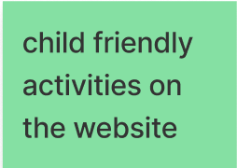
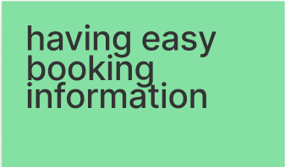
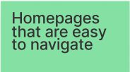

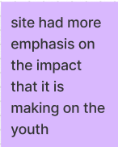
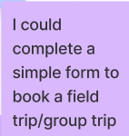
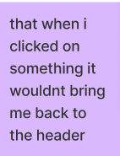

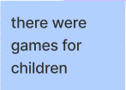

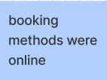
Ideation
We thought about what is, what can be and what could be
Notes:
Chels
https://www.figma.com/file/0ileUbVTdEF1aKiFIYq3xq/Discovery-Museum--I-Like-%7C-I-Wish-%7C-What-if?type=whiteboard&t=FyPDo6RdIYBLgKm6-1

Slide 11
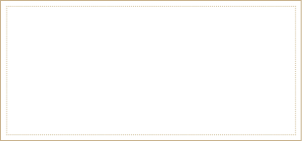
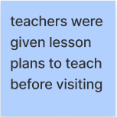
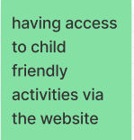
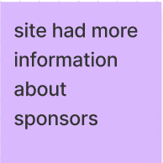
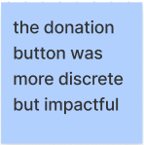
Feature Prioritization Matrix
We identified the needs we believed we could tackle.
High Priority
Low Feasibility
High Feasibility
Low Priority
Notes:
chels
https://www.figma.com/file/0ileUbVTdEF1aKiFIYq3xq/Discovery-Museum--I-Like-%7C-I-Wish-%7C-What-if?type=whiteboard&t=FyPDo6RdIYBLgKm6-1

Slide 12
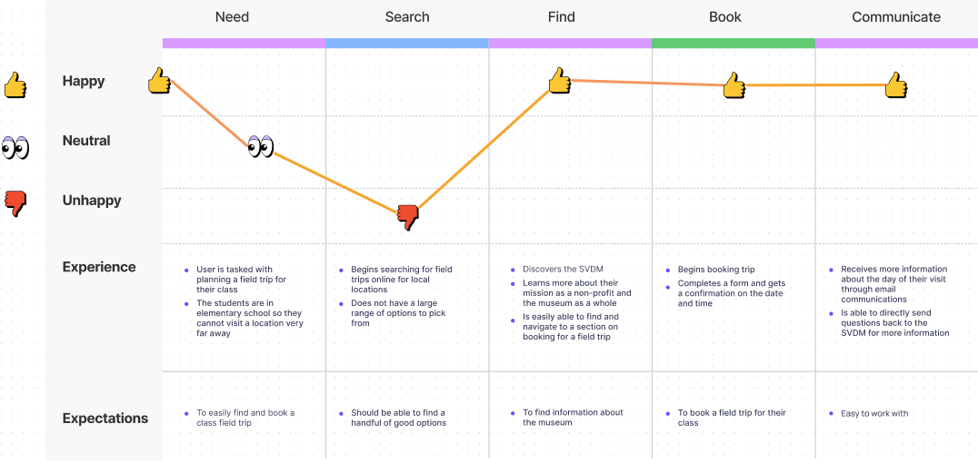
User Journey Map
Notes:
chels
https://www.figma.com/file/kDKwygd8HzAALJGsUAXimn/SVDM-User-Journey-Map?type=whiteboard&t=FyPDo6RdIYBLgKm6-1

Slide 13
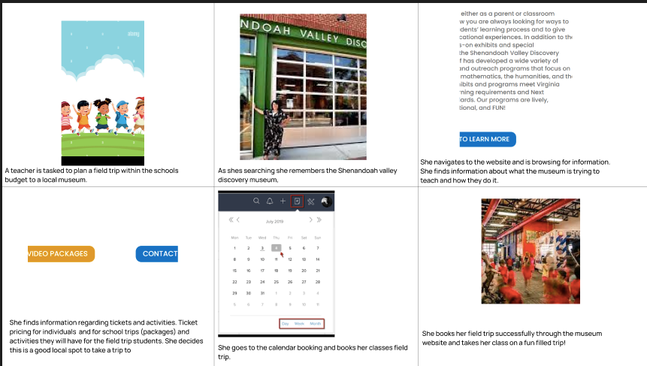
Storyboard
Notes:
chels
https://www.figma.com/file/tnPom62ff0thVJjiOD7h0u/Storyboard?type=design&t=FyPDo6RdIYBLgKm6-1

Slide 14
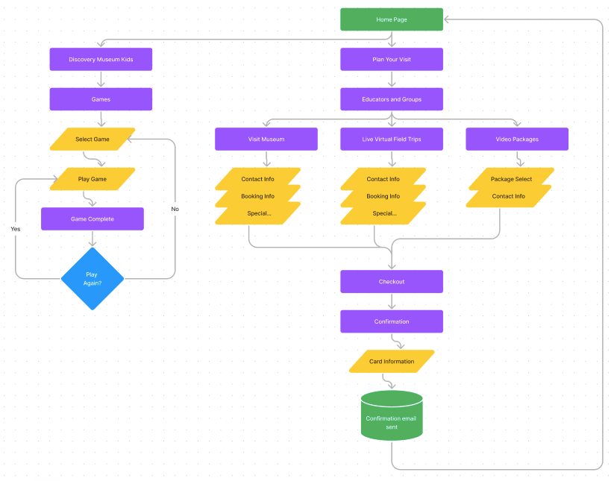
User Flow
Notes:
cam
https://www.figma.com/file/1e9uvHYjqVezyo5h9D8YTh/User-Flow?type=whiteboard&t=FyPDo6RdIYBLgKm6-1

Slide 15
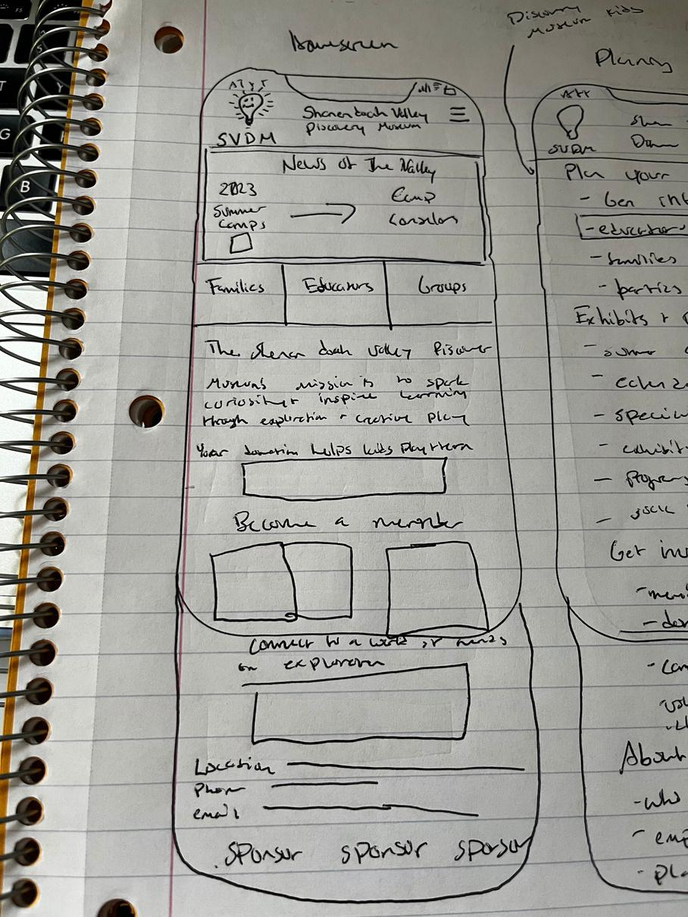
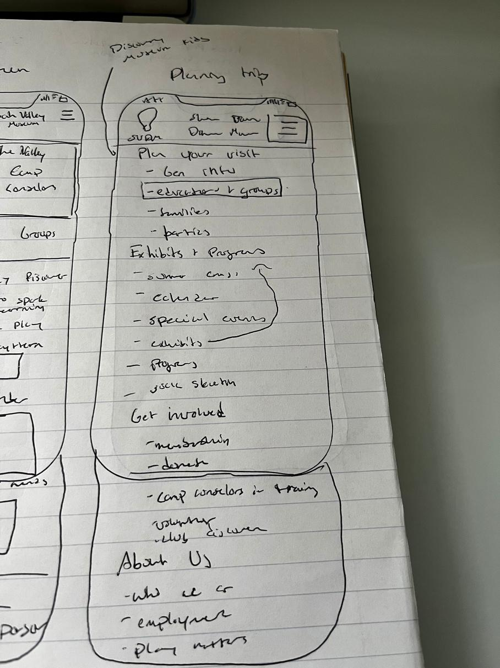
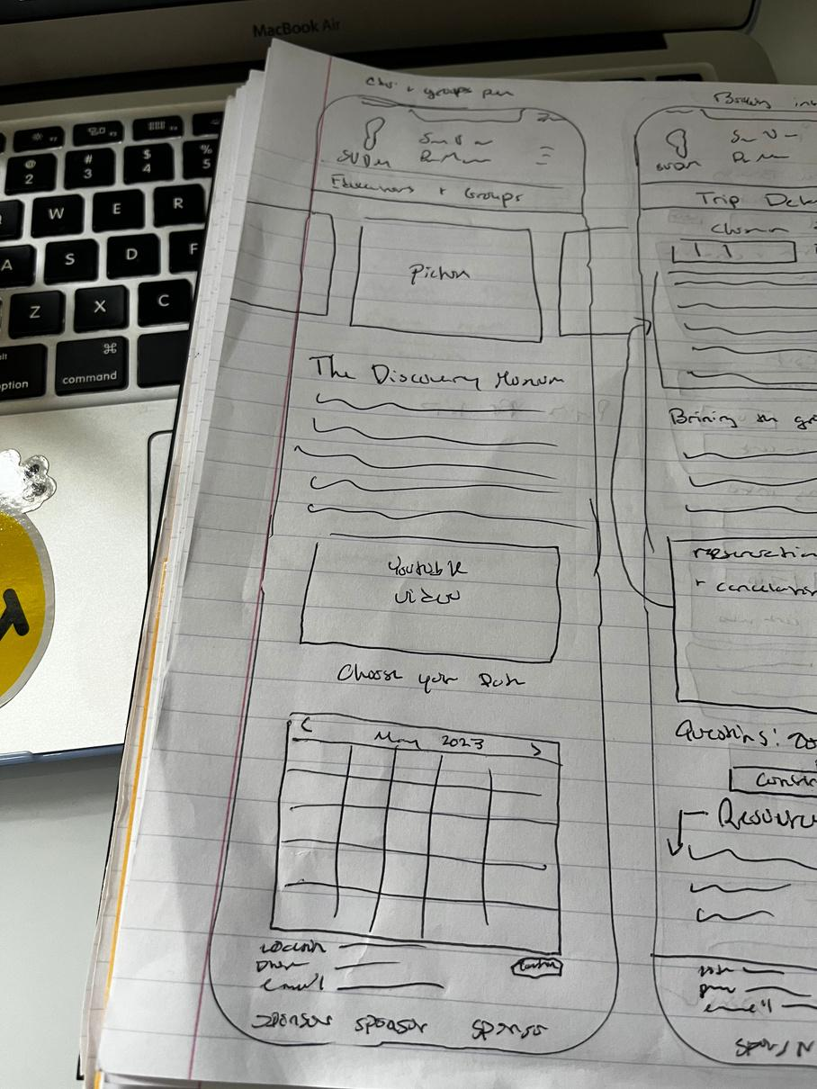
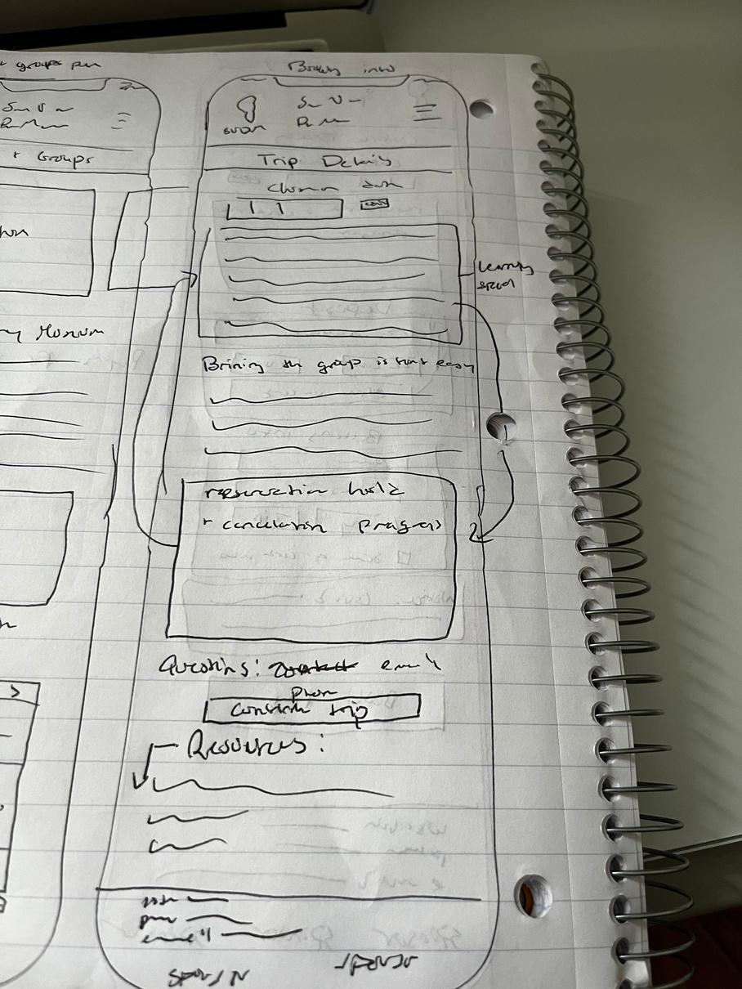
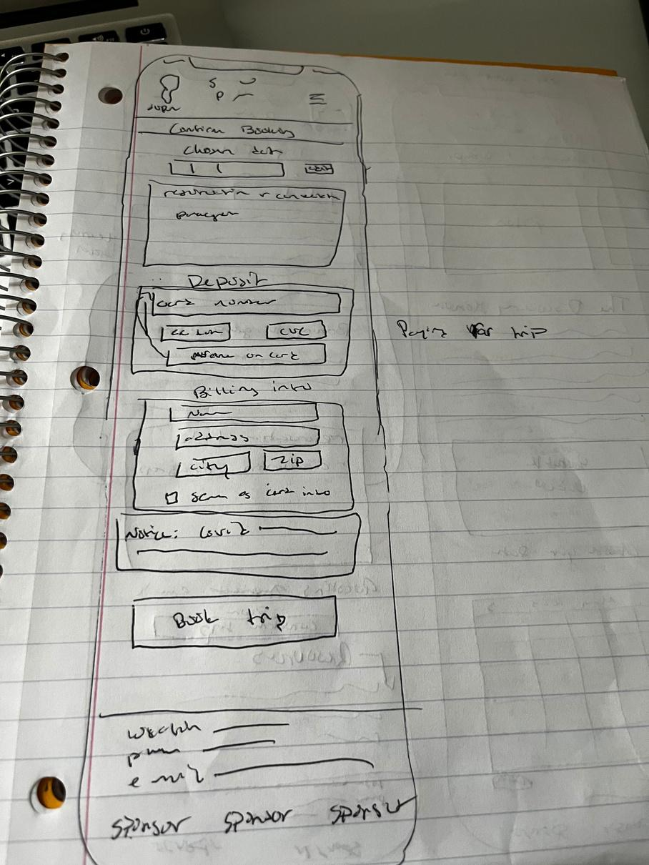
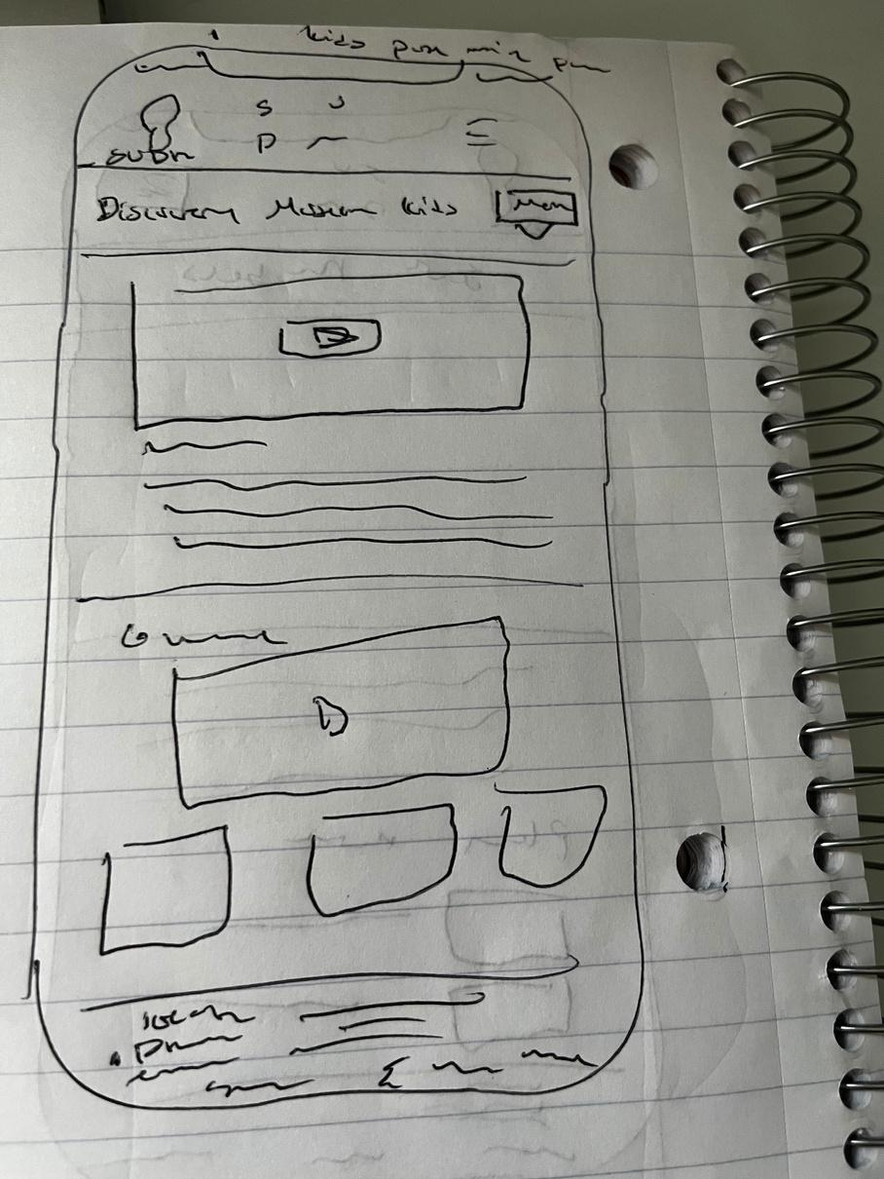
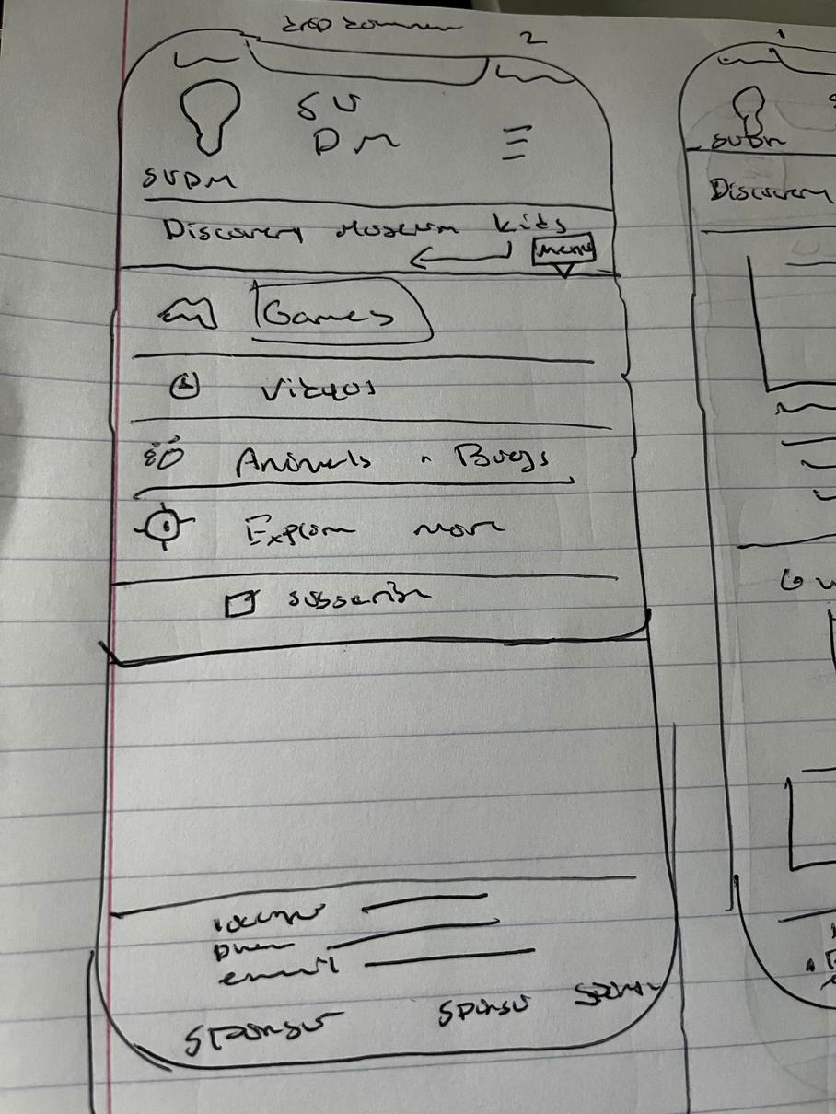
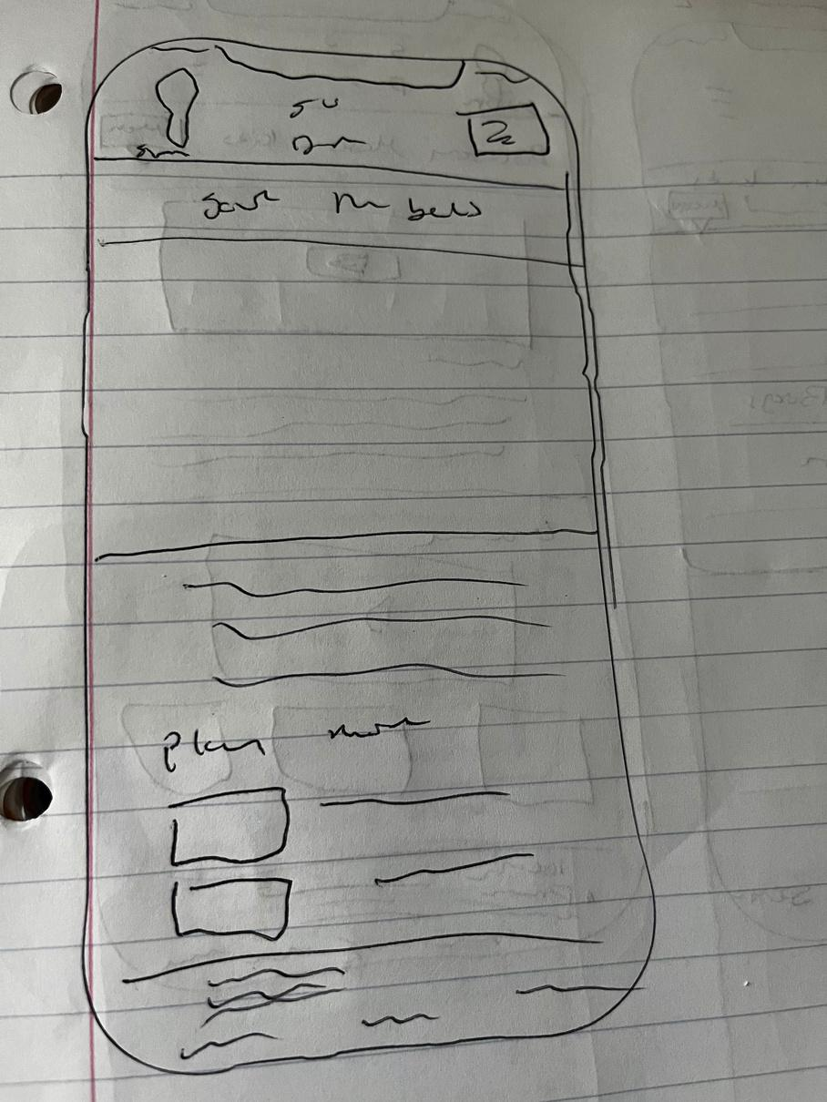
Paper Wireframes
Ashlyn's Prototype
Notes:
cam

Slide 16
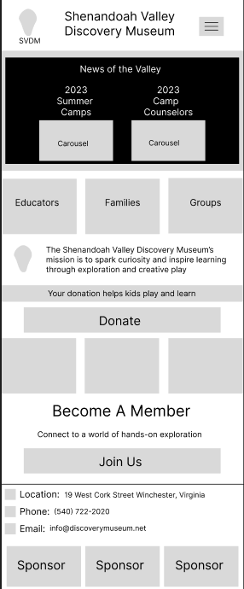
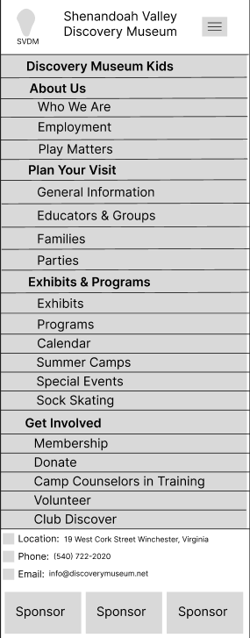
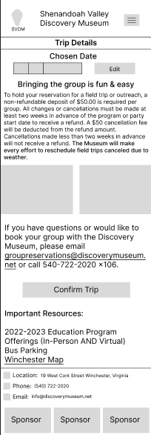
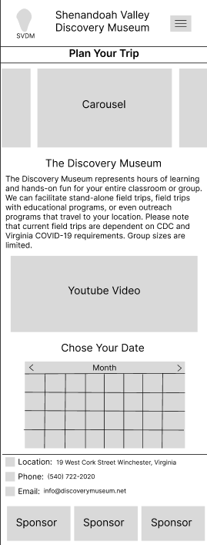
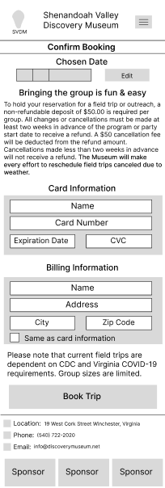
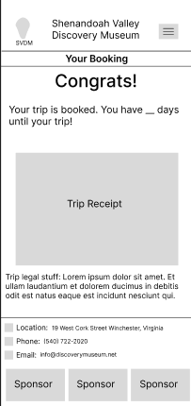
Low-Fi Prototype
Cameron's Prototype
Notes:
cam
https://www.figma.com/file/3H9i7wiURbHnGoeyeORJEy/Lo-fi-and-Hi-Fi?type=design&t=FyPDo6RdIYBLgKm6-1

Slide 17
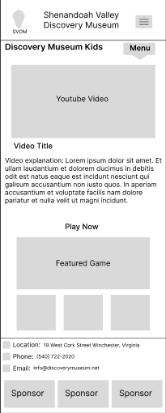
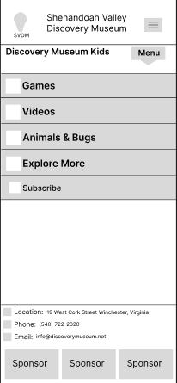
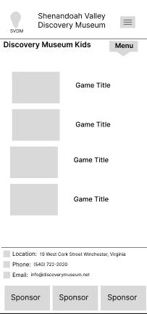
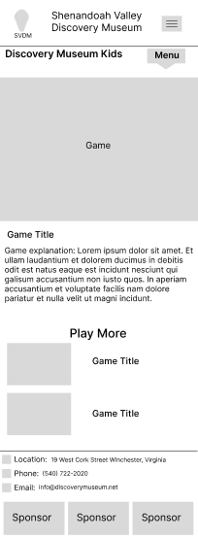
Low-Fi Prototype
Notes:
cam

Slide 18
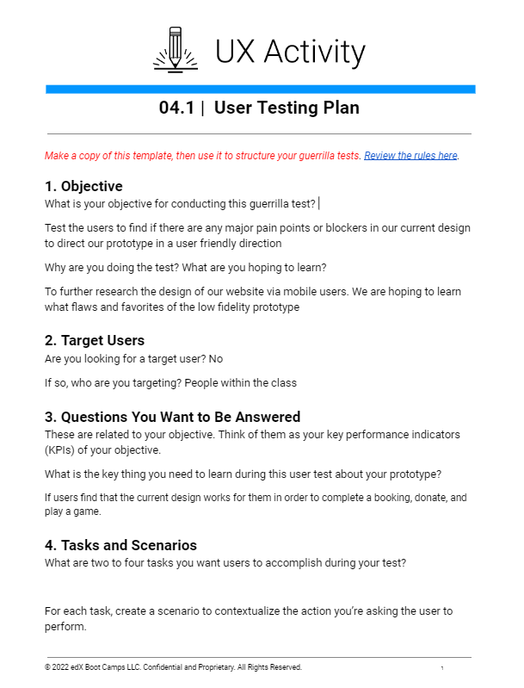
User Testing Round 1
Notes:
https://drive.google.com/drive/folders/1DuSzZAJaF0YUSfyYf0DnoES5X4JUEWp_?usp=sharing

Slide 19
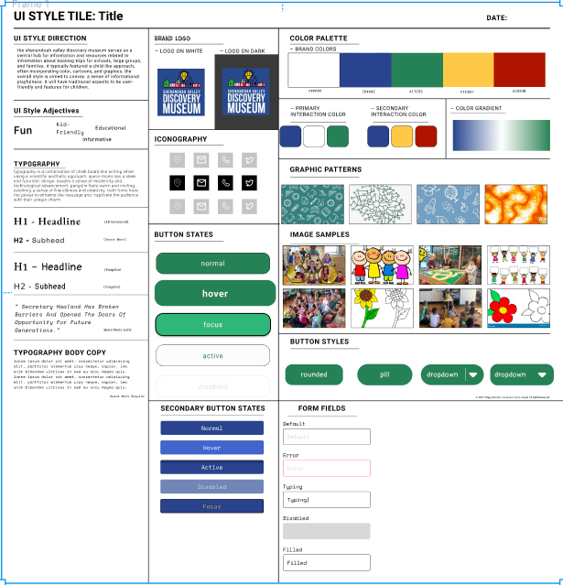
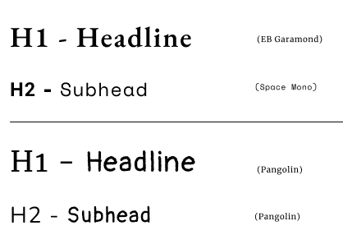
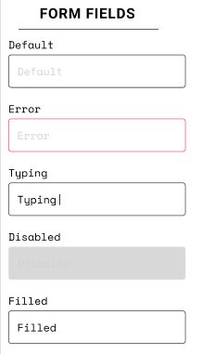
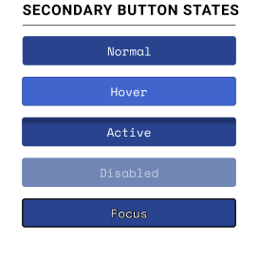
Style Guide
Notes:
Ashlyn
https://www.figma.com/file/VcWdQPYpngr2a8oz3CMm9n/style-guide?type=design&t=FyPDo6RdIYBLgKm6-1

Slide 20
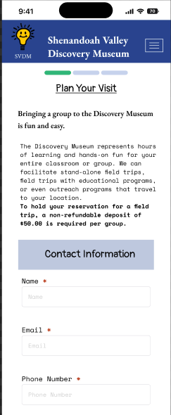
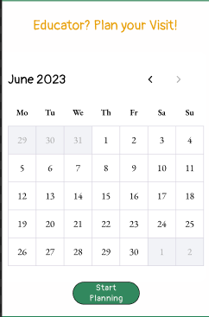

Iterations
Add contact information for booking
Move booking calendar
Condense text
Make kids access easier to find
Add planning trip feature to landing page
Based on our key findings, these are the iterations we made to our prototype as concluded from our findings
Notes:
Ashlyn

Slide 21

Iterated User Flow
Notes:
cam

Slide 22

User Testing Round 2
Notes:
https://drive.google.com/drive/folders/1YGjcgGX8O9amTDxaHb5S9CiNqdAm_yWb?usp=sharing

Slide 23








Mobile Prototype
Notes:
https://www.figma.com/proto/CRPEL3LM40yL0yDOmitx7D/Hi-Fi-cool-stuff?type=design&node-id=5-2862&scaling=scale-down&page-id=0%3A1&starting-point-node-id=5%3A2862&show-proto-sidebar=1

Slide 24








Mobile Prototype
Notes:
chels

Slide 25


Desktop Wireframes (RWD)
Notes:
yishak

Slide 26

Future Plans
Booking for families, parties, and groups
Virtual tours
Lesson plans that compliment the exhibits
At home science projects/DIY’s
Educational video packages
Notes:
yishak

Slide 27
Questions?
Notes:
yishak

